Slide 1





Evaluation des modulateurs de CFTR en conditions réelles d’utilisation chez l’adolescent et l’adulte
Pierre-Régis Burgel MD, PhD
Paris, France

Slide 2

Liens d’intérêt
I have the following, real or perceived direct or indirect conflicts of interest that relate to this presentation:
Affiliation / financial interest | Nature of conflict / commercial company name
Tobacco-industry and tobacco corporate affiliate related conflict of interest | None
Grants/research support (to myself, my institution or department): | Vertex
Honoraria or consultation fees: | Vertex
Participation in a company sponsored bureau: | None
Stock shareholder: | None
Spouse/partner – conflict of interest (as above): | None
Other support or other potential conflict of interest: | None
This event is accredited for CME credits by EBAP and speakers are required to disclose their potential conflict of interest going back 3 years prior to this presentation. The intent of this disclosure is not to prevent a speaker with a conflict of interest (any significant financial relationship a speaker has with manufacturers or providers of any commercial products or services relevant to the talk) from making a presentation, but rather to provide listeners with information on which they can make their own judgment. It remains for audience members to determine whether the speaker’s interests or relationships may influence the presentation. Drug or device advertisement is strictly forbidden.

Slide 3
Programme Orkambi lumacaftor/ivacaftor
Programme initié en 2016. ATU de cohorte puis AMM
845 patients inclus
3 articles publiés
Plusieurs études en cours

Slide 4
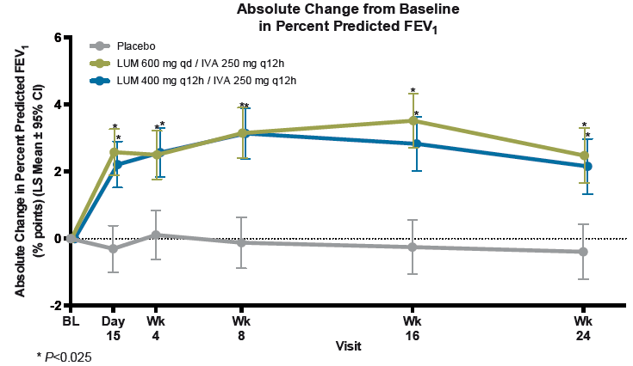
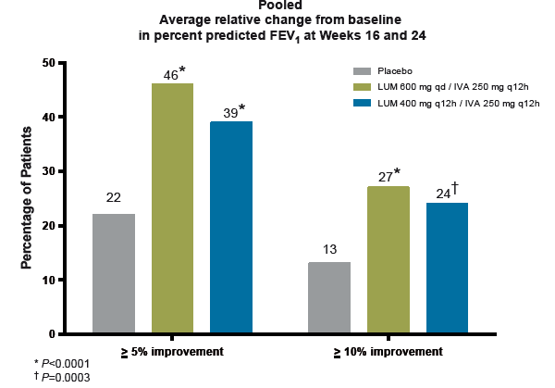

Lumacaftor + Ivacaftor F508del homozygotes
Etudes Phase 3: TRAFFIC/TRANSPORT
Patients avec VEMS 40-90%
12 ans et plus
-Efficacité: function respiratoire, exacerbation
-Taux d’arrêt du traitement
-Lumacaftor-ivacaftor: 4.2%
-Placebo: 1.6%
Juillet 2015: FDA approval
Nov 2015: EMA approval
Orkambi™ (lumacaftor/ivacaftor) to treat F508del/F508del CF patients aged 12 and older
Notes:
Pas d'effet sur sueur

Slide 5
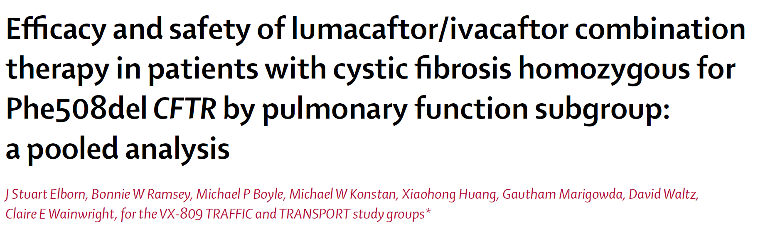
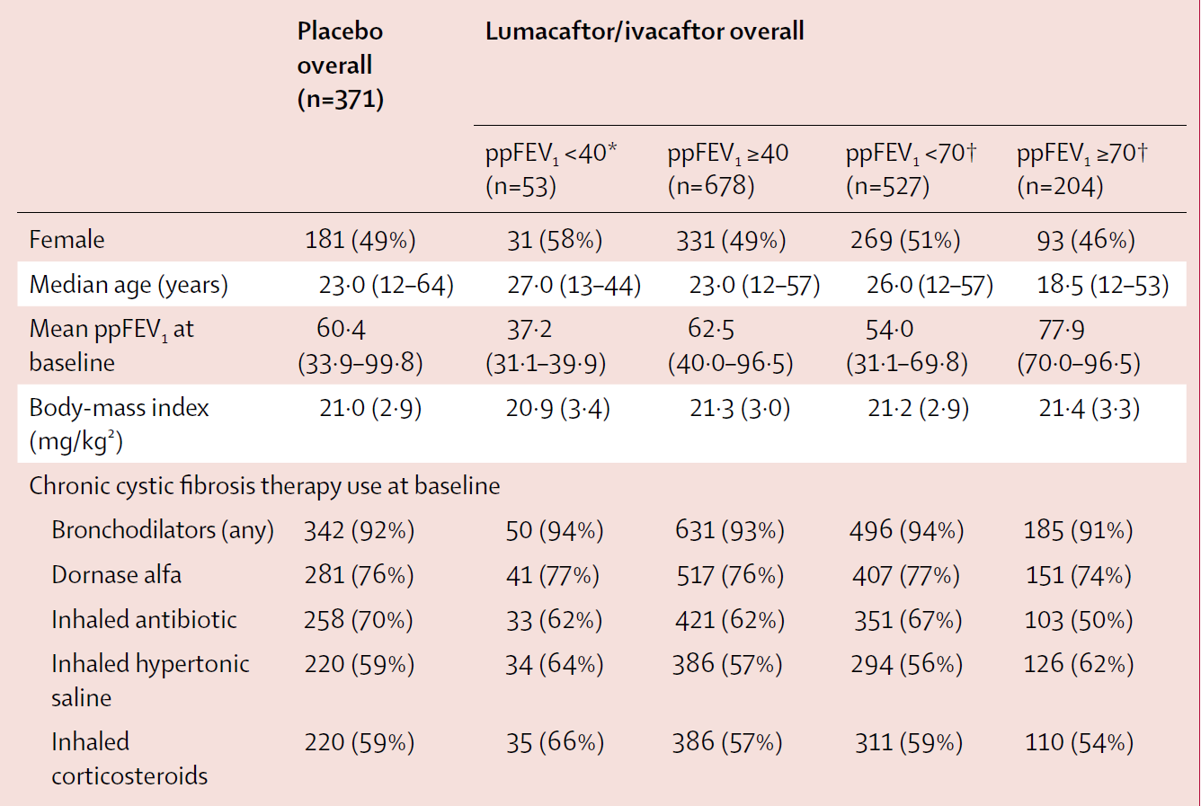
Lumacaftor + Ivacaftor F508del homozygotes
Patients with VEMS 40-90%
vs.
Patients <40% entre le screening and baseline
-Efficacy: fonction respiratoire, exacerbation
Taux d’arrêt du traitement
VEMS<40%
Luma-Iva: 4%; Placebo 2%
“Treatment was generally well tolerated, although the incidence of some respiratory adverse events was higher with lumacaftor/ivacaftor than with placebo in all subgroups”
http://dx.doi.org/10.1016/
S2213-2600(16)30121-7
Notes:
Pas d'effet sur sueur

Slide 6

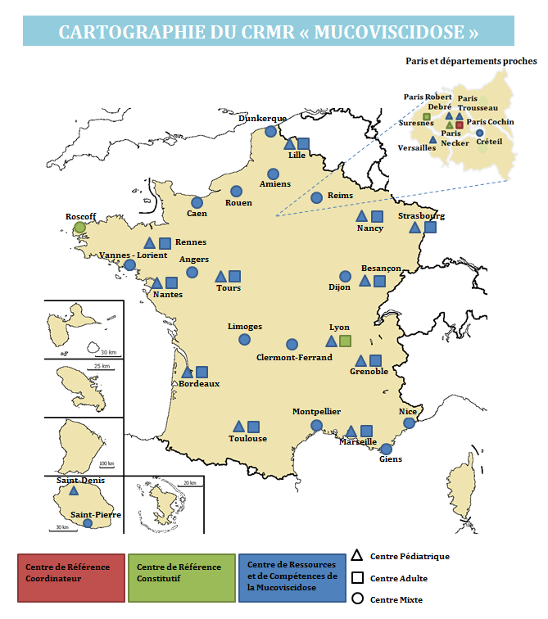
47 pediatric and adult CF centers
The French CF Reference Network
7500 patients
All followed in the Reference CF centers
French CF Registry
9 transplant centers

Slide 7
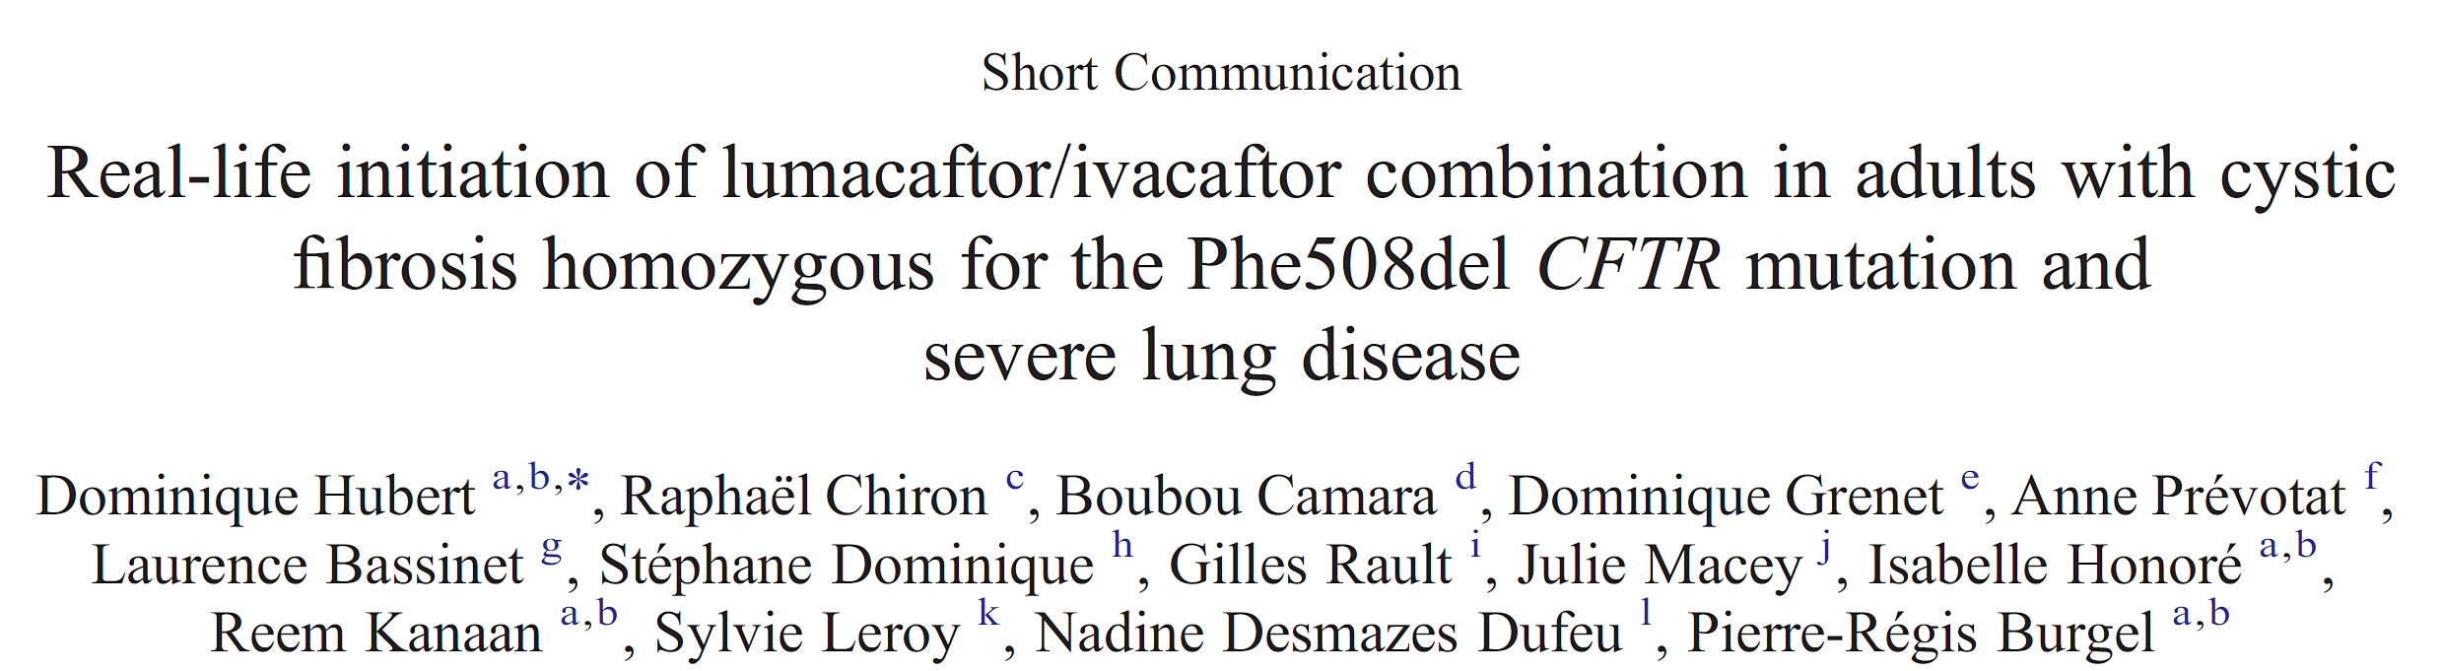

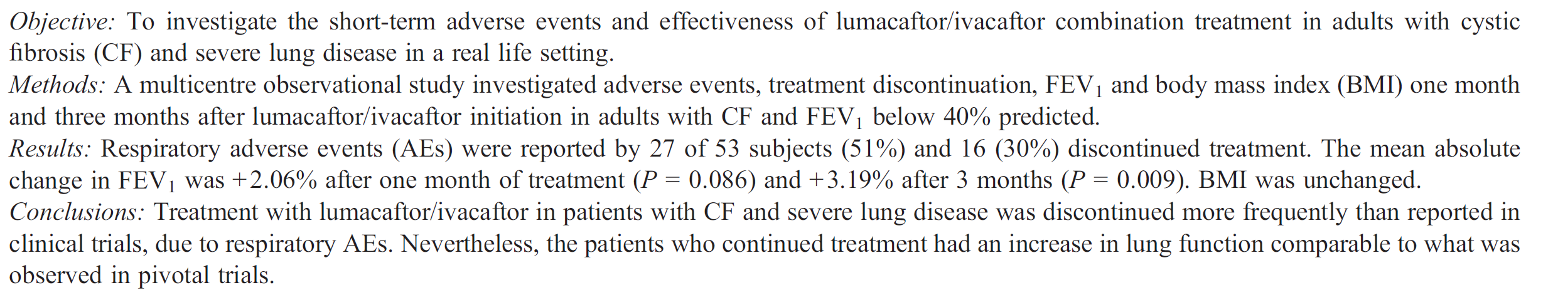
Early data
Journal of Cystic Fibrosis 16 (2017) 388–391

Slide 8
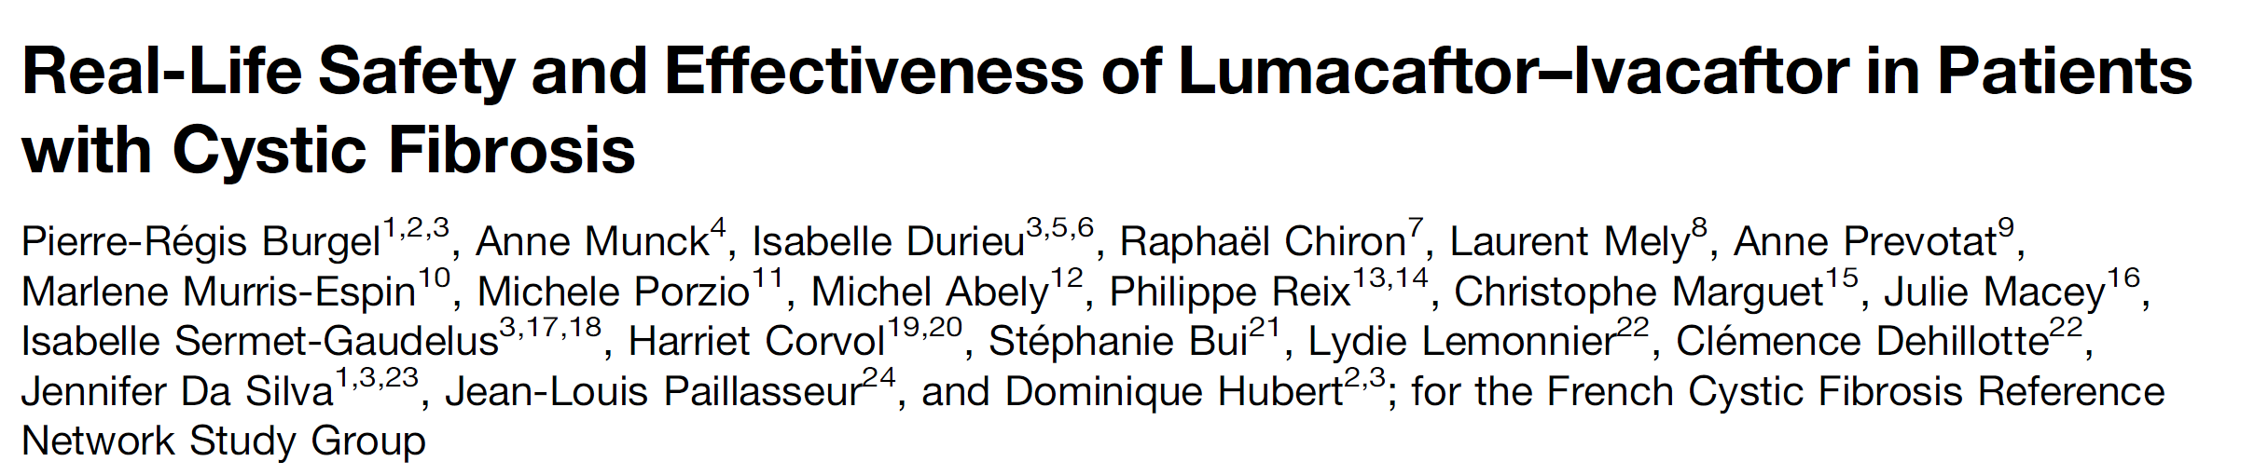
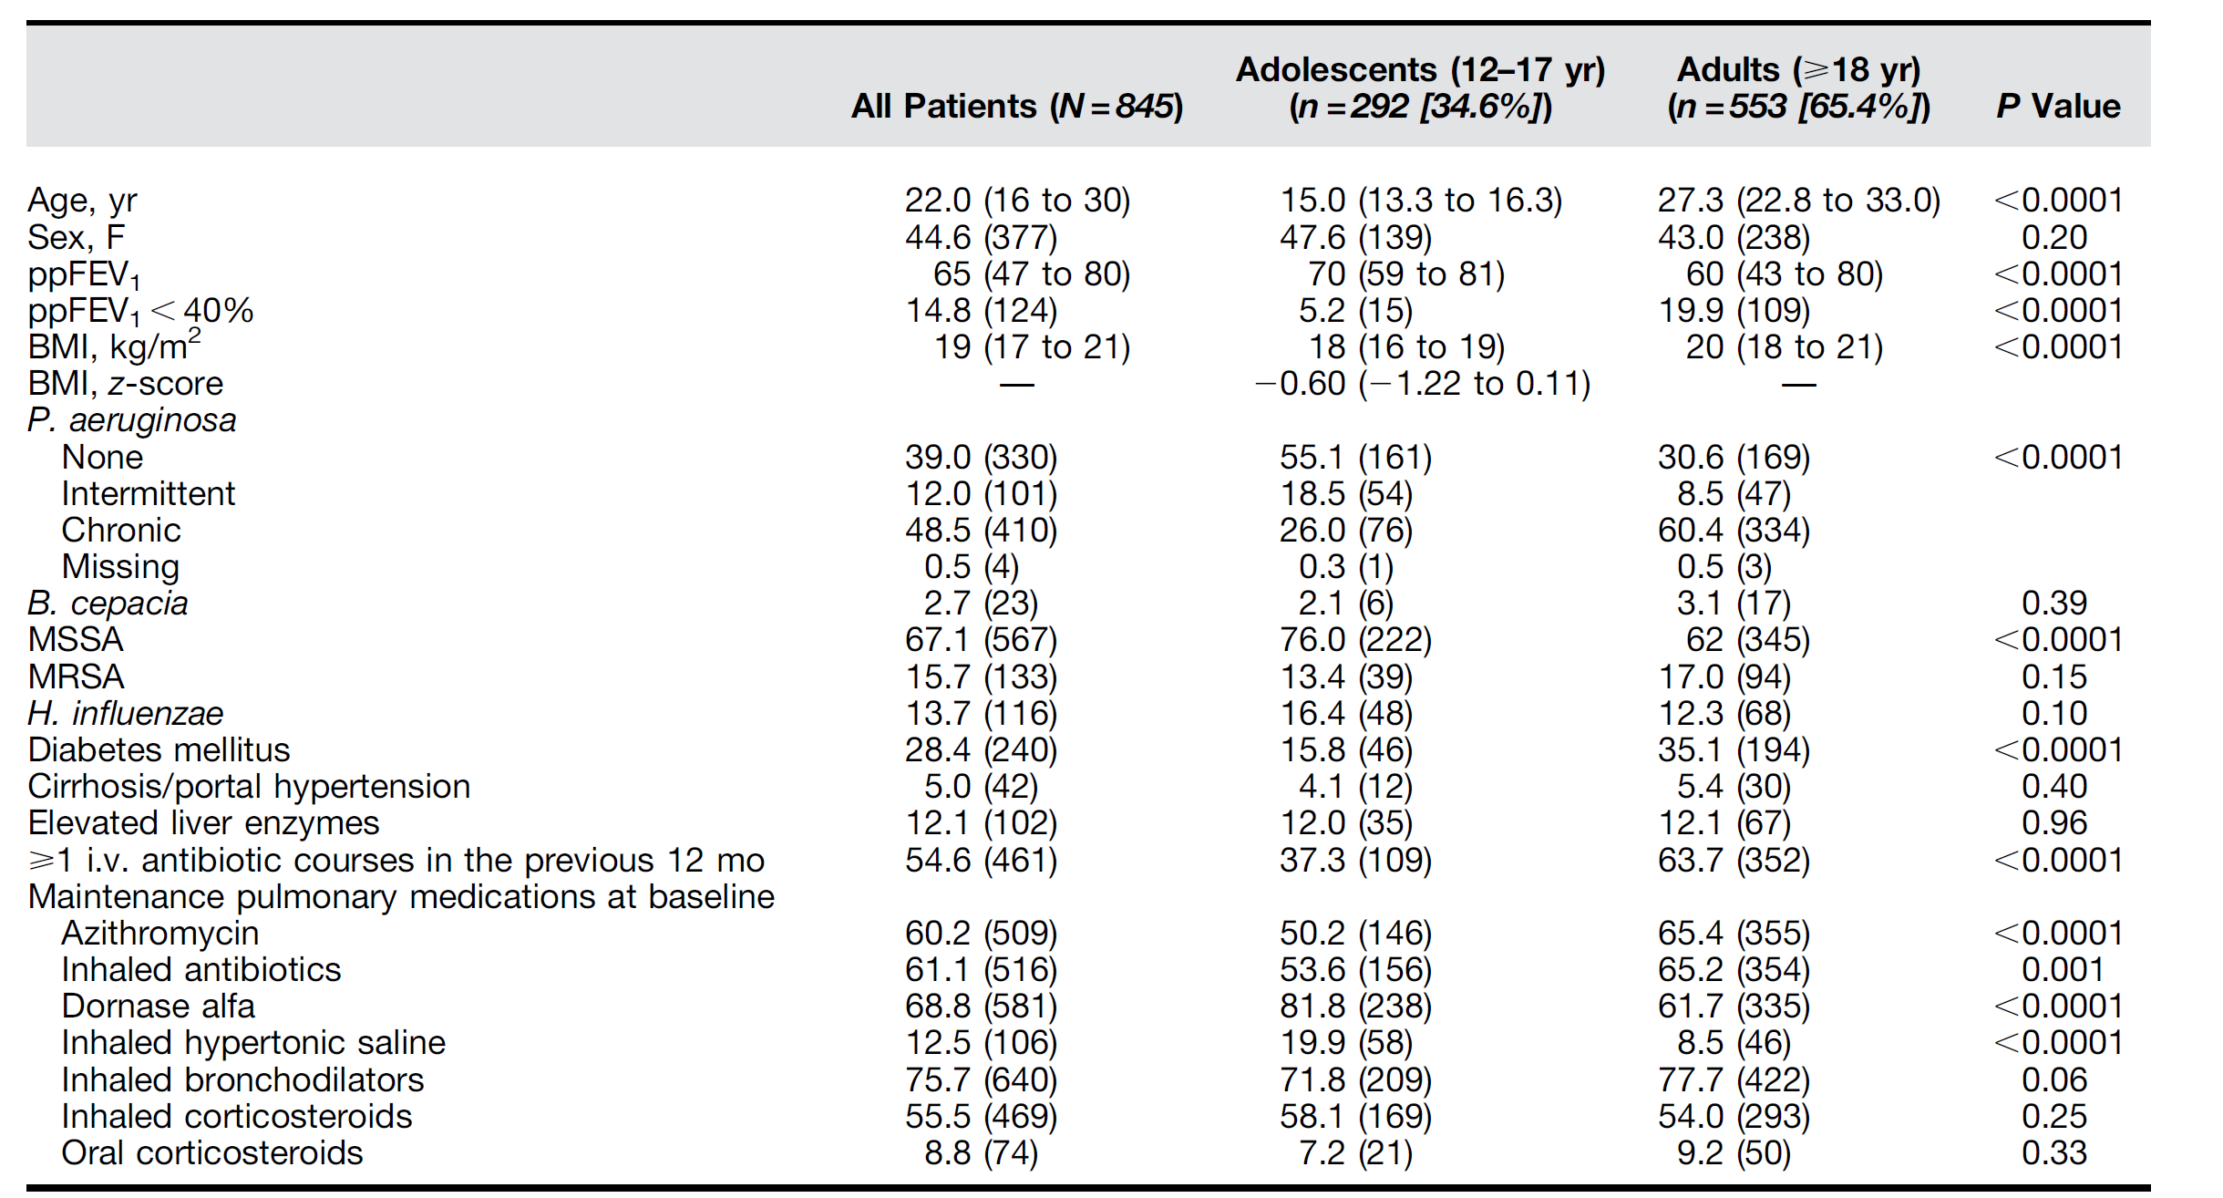
Patients ≥12 ans
ayant débuté
Lumacaftor-Ivacaftor
in 2016
N=845 patients
47 CRCM
Suivi prospectif 1 an
Recommandation SFM
Registre Français de la Muco
Am J Respir Crit Care Med Vol 201, Iss 2, pp 188–197, Jan 15, 2020

Slide 9
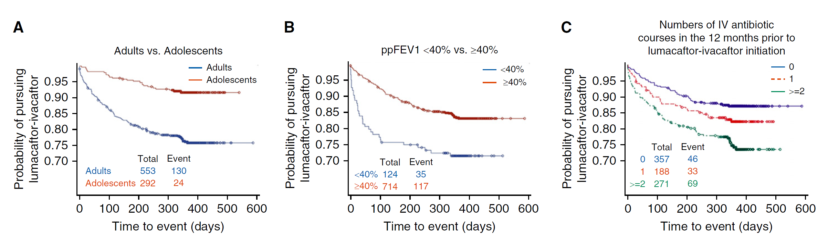
Lumacaftor-Ivacaftor discontinuation: n=154/845 (18.2%)
Rates of
discontinuation
Adults: 23.5%
Adolescents: 8.2%
ppFEV₁<40: 28.2%
ppFEV₁≥40: 16.3%
0 exacerbation: 12.9%
≥2 exacerbations: 25.5%
Am J Respir Crit Care Med Vol 201, Iss 2, pp 188–197, Jan 15, 2020

Slide 10
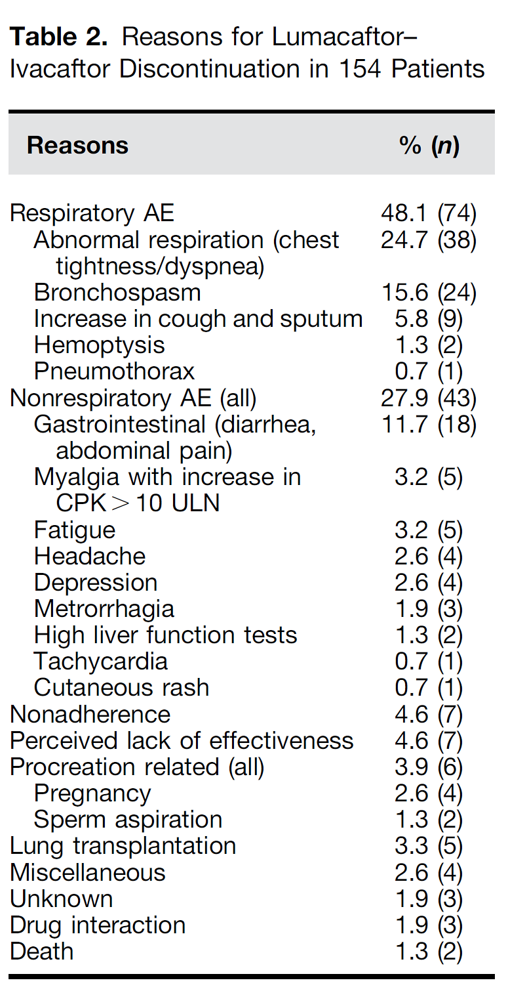
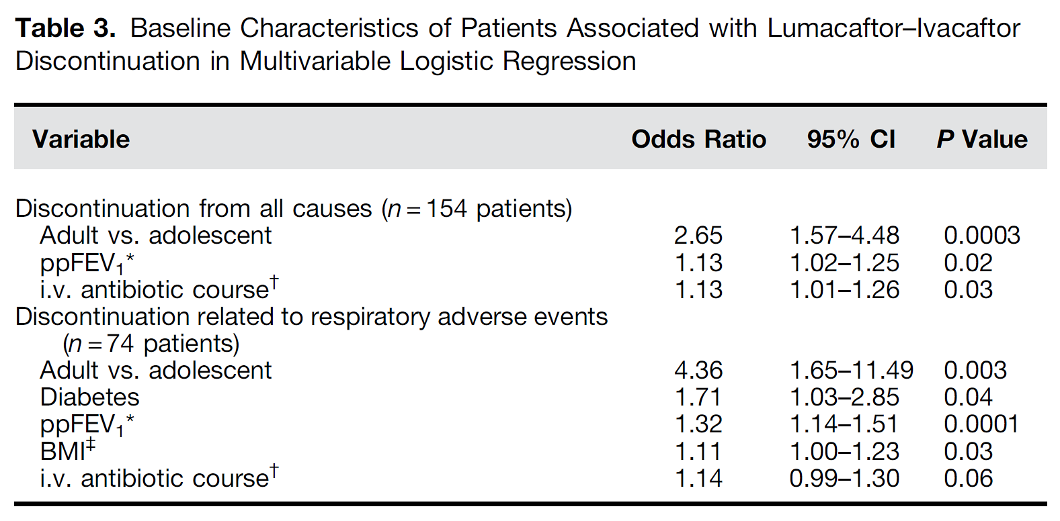
Am J Respir Crit Care Med Vol 201, Iss 2, pp 188–197, Jan 15, 2020

Slide 11
Safety: liver disease
Liver Cirrhosis
Elevated liver enzyme
>3N during follow-up
Am J Respir Crit Care Med Vol 201, Iss 2, pp 188–197, Jan 15, 2020

Slide 12
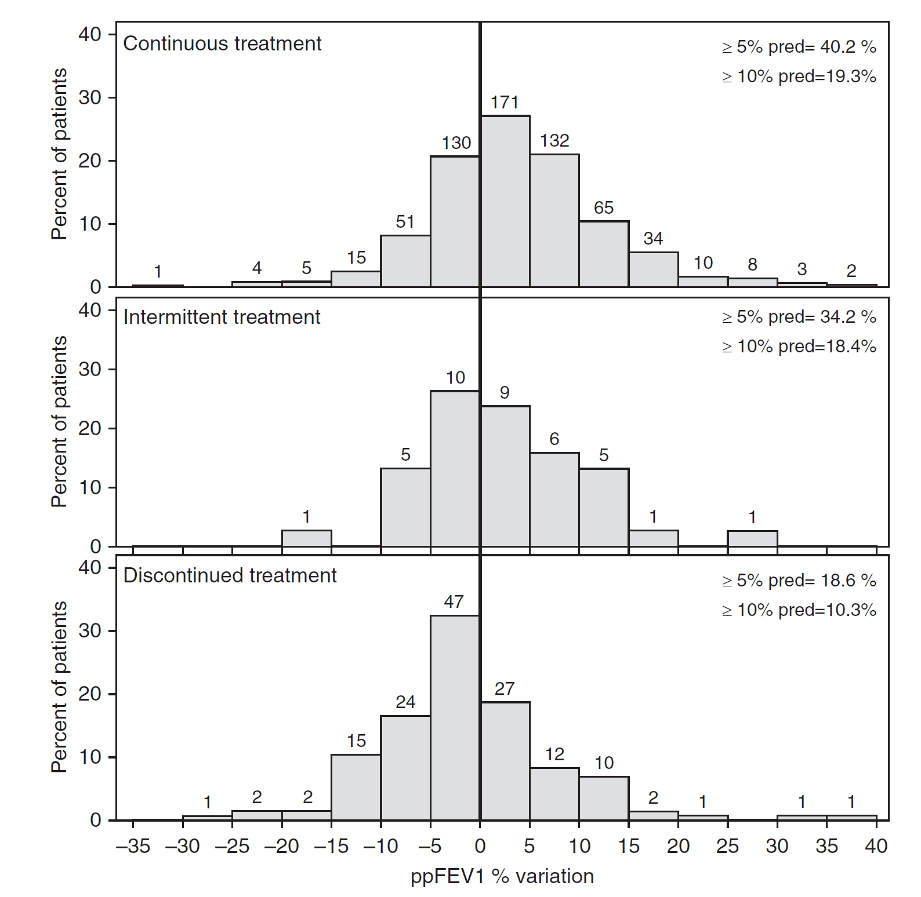
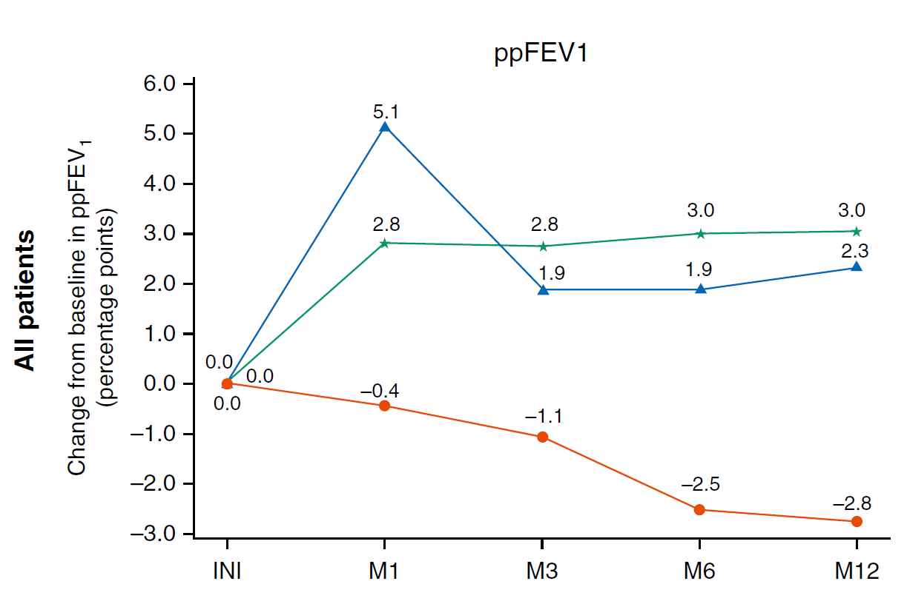
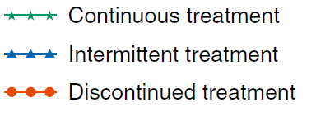
Am J Respir Crit Care Med Vol 201, Iss 2, pp 188–197, Jan 15, 2020

Slide 13
Exacerbations, IV antibiotics
Continuous Treatment n=641
 | Mean
IV antibiotic courses, 12 months before | 1.18
IV antibiotic courses, 12 months after | 0.77
Days of IV antibiotics 12 months before | 17.57
Days of IV antibiotics 12 months after | 11.37
Discontinued treatment n=154
 | Mean
IV antibiotic courses, 12 months before | 1.82
IV antibiotic courses, 12 months after | 1.82
Days of IV antibiotics 12 months before | 32.11
Days of IV antibiotics 12 months after | 28.57
Intermittent treatment n=39
 | Mean
IV antibiotic courses, 12 months before | 1.44
IV antibiotic courses, 12 months after | 1.50
Days of IV antibiotics 12 months before | 20.37
Days of IV antibiotics 12 months after | 23.03
-35% ; P<0.001
NS
NS
Am J Respir Crit Care Med Vol 201, Iss 2, pp 188–197, Jan 15, 2020

Slide 14
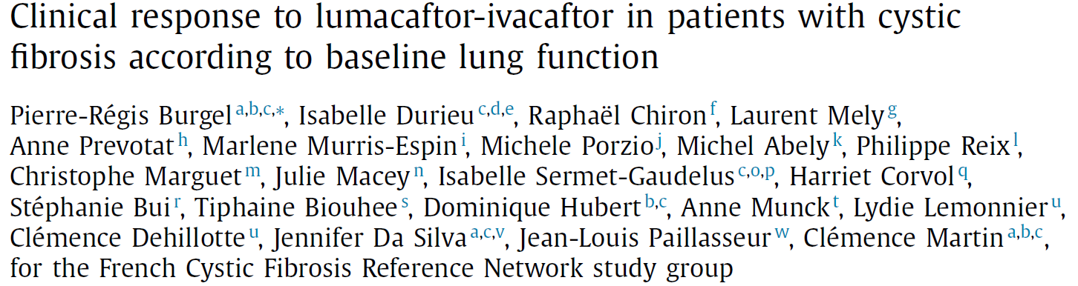
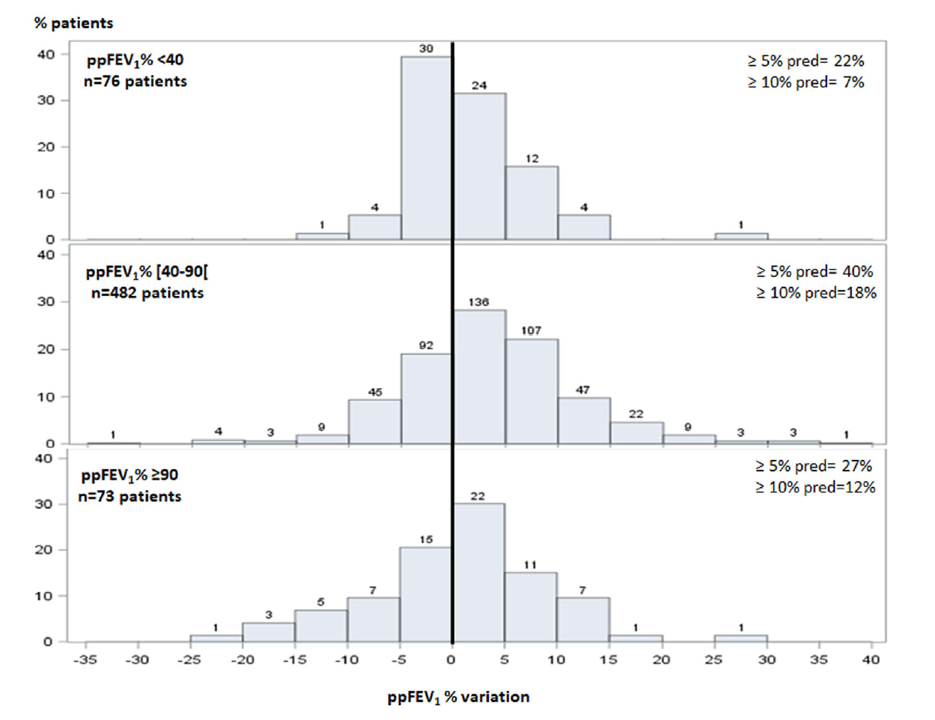
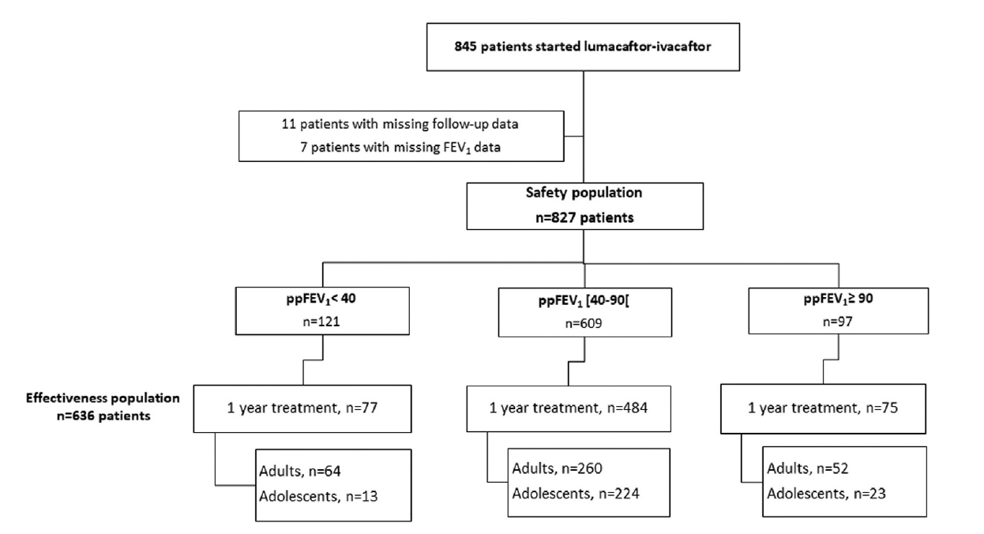
+ 0.5%, P = 0.03
+ 2.9%, P < 0.001
+1.7% , P = 0.46

Slide 15
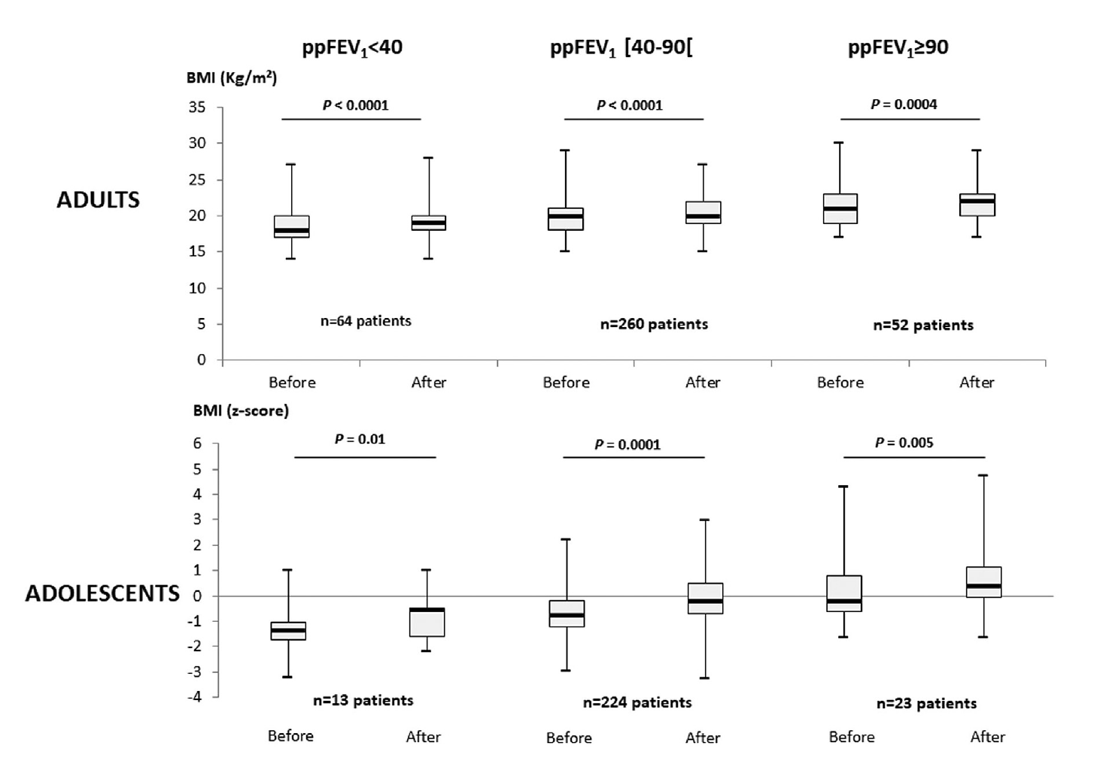
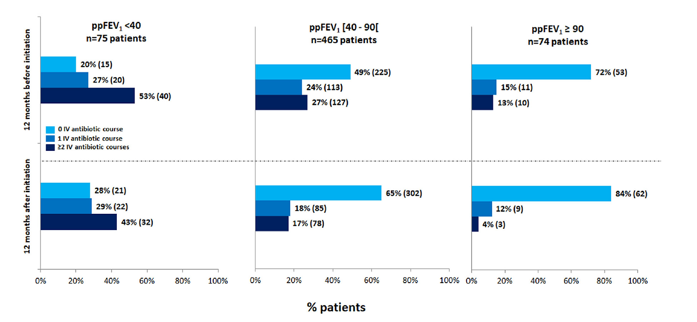
Body Mass Index
Exacerbations

Slide 16
Orkambi: Etudes ancillaires en cours/programmées
Imagerie (Guillaume Chassagnon):
  Comparaison TDM avant/après mise sous traitement
  Recherche de facteurs prédictif d’efficacité en fonction du TDM initial
Lung clearance index (Philippe Reix)
Critères multidimensionnels d’efficacité (Pierre-Régis Burgel)
Efficacité tolérance à 3 ans (Pierre-Régis Burgel)

Slide 17
Conclusions: Programme Orkambi
Etude observationnelle « vrai-vie » ayant inclus un grand nombre de patients
Taux d’arrêt du traitement 3 à 4 fois plus élevés que dans les essais cliniques.
Patients moins stables/plus sévères
Confirmation de l’efficacité chez ceux qui peuvent continuer le traietment par lumacaftor-ivacaftor (VEMS, IMC, exacerbations)
Données de sécurité d’emploi dans certaines sous-populations (cirrhoses++)
Un complément utile aux données de phase 3.

Slide 18
Programme Kaftrio (ATU nominative) elexacaftor/tezacaftor/ivacaftor
Programme initié en décembre 2019. AMM européenne 21 août 2020. Commission transparence novembre 2020.
12 ans et plus, au moins une mutation Phe508del
Pathologie sévère VEMS<40% et/ou évolution vers une greffe pulmonaire.
Environ 350 patients inclus
Inclusions toujours en cours tant que le traitement n’est pas disponible.
Données initiales prochainement disponibles

Slide 19

Remerciements
47 French CF centers: doctors, nurses, ……
People with CF and their parents
Funding:
  Vaincre la Mucoviscidose
  Société Française de la Mucoviscidose
  Legs Pascal Bonnet
  Filière mucoCFTR
Special thanks:
  Jennifer Da Silva (data management)
  Jean-Louis Paillasseur (statistics)
  French CF Registry team:
  Lydie Lemonnier
  Clémence Dehillotte

